Slide 1
Mysteries of The Veil Nebula
Developed by the cosmic coders

Slide 2

Introduction

Slide 3
Video Demo

Slide 4

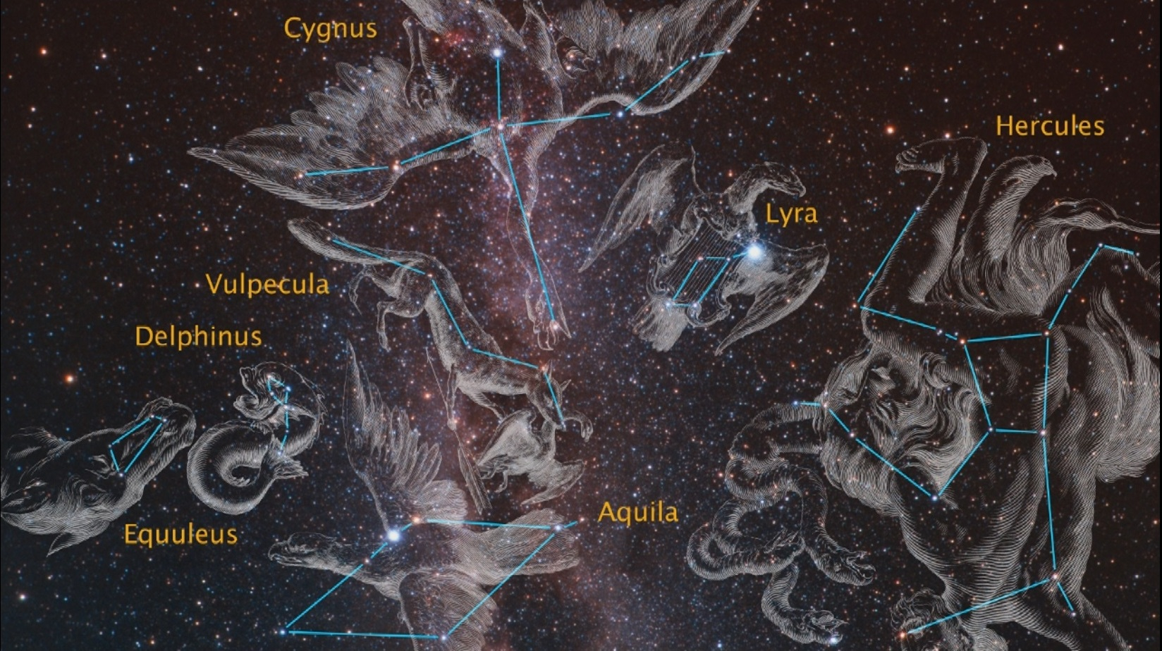
Future Considerations
New Mechanics (e.x Inventory, User Decryption, etc.)
Travel among various constellations
Expanded narrative

